Slide 1
iGroup - Final Presentation
“Realization of survey based grouping algorithms”
“Proof of concept for scored based algorithms”

Slide 2
Team members :
Shawn (baymax@bu.edu) - Team leader
Dawei (davidyin@bu.edu)- Design and Implementation leader
Lijian (yao049@bu.edu) - Configuration leader
Alex (alexrw@bu.edu)- Security leader
Siming (s1a1d1f1@bu.edu)- Requirement Leader
Haiyang (whaiyang@bu.edu) - QA leader

Slide 3
Contents
Introduction
Algorithm
Development Detail
Demo
Conclusion

Slide 4
Introduction
Project Description: Our project is making a team assignment tool that can automatically assign students to a team, which involves the concepts of front-end, back-end, database and so on. We named it "iGroup". The main idea of the Team assignment tool is to help create teams based on students preferences and background. Algorithmically, we weight different preferences to create the most appropriate team.
High-level Description: A Web-based Application for team assignment
Motivation: Help professors automatically assign teams based on the survey while focusing on Class Size which is around 100 to 200 students.
Goal: Efficiently form teams and visualize the results on web page

Slide 5
Introduction
iGroup
Replace manual grouping with survey
Integrate the answers included weight
Calculate the score for the assigned group
Swap the members until made the best team

Slide 6
Configuration Management plan
Tools we used:
Version Control: Git,Github
Front end: VS Code(HTML,CSS)
Back end: PyCharm(IDE), framework: Django
Project management: Pivotal Tracker
Database:SQLite
Git Branching Strategy
GitHub-Flow
GitHub Flow is a very suitable Git Branching Strategy for a small team like us. It allows us to all develop together effectively. and the pull request will be reviewed by every team member, especially the techlead(David) before the merge. And It seems work well for our project.

Slide 7
Algorithm
Score Calculate
Team-Maker supports four types of questions:
1. Multiple-choice
2. Choose-any-or-all-of

Slide 8
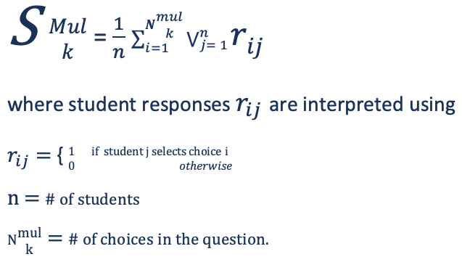
Algorithm
#1 Multiple - choice Question
The greater the number of options that the team members select in common, the closer the score approaches zero, indicating team homogeneity on this question.

Slide 9
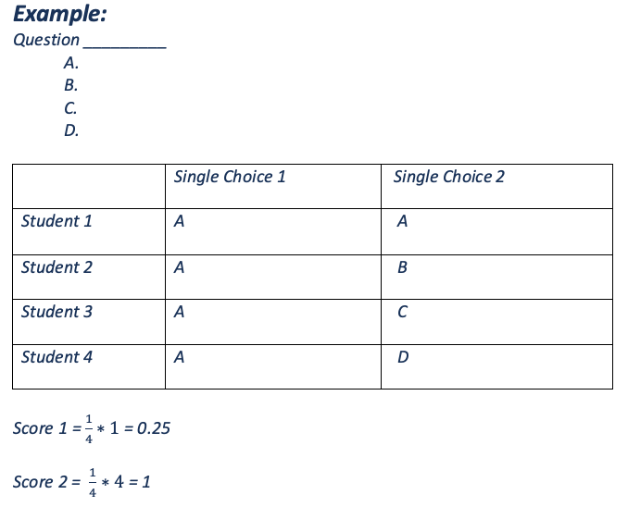
Algorithm
#1 Multiple - choice Question

Slide 10
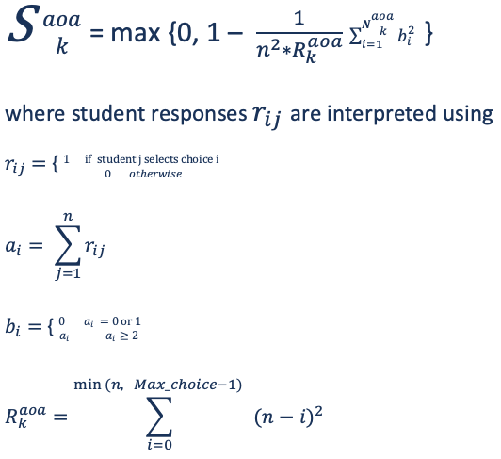
Algorithm
#2 Choose-any-or-all-of Question

Slide 11
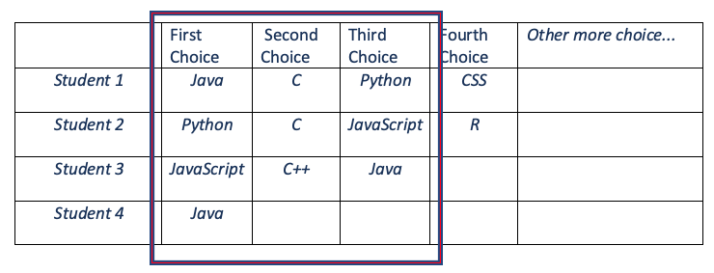
Algorithm
#2 Choose-any-or-all-of Question
Example #1 :
Question: Please select the programming language you are best at in order
【 Java, Python, R, C, C++, JS, CSS, etc.】
Answer:

Slide 12
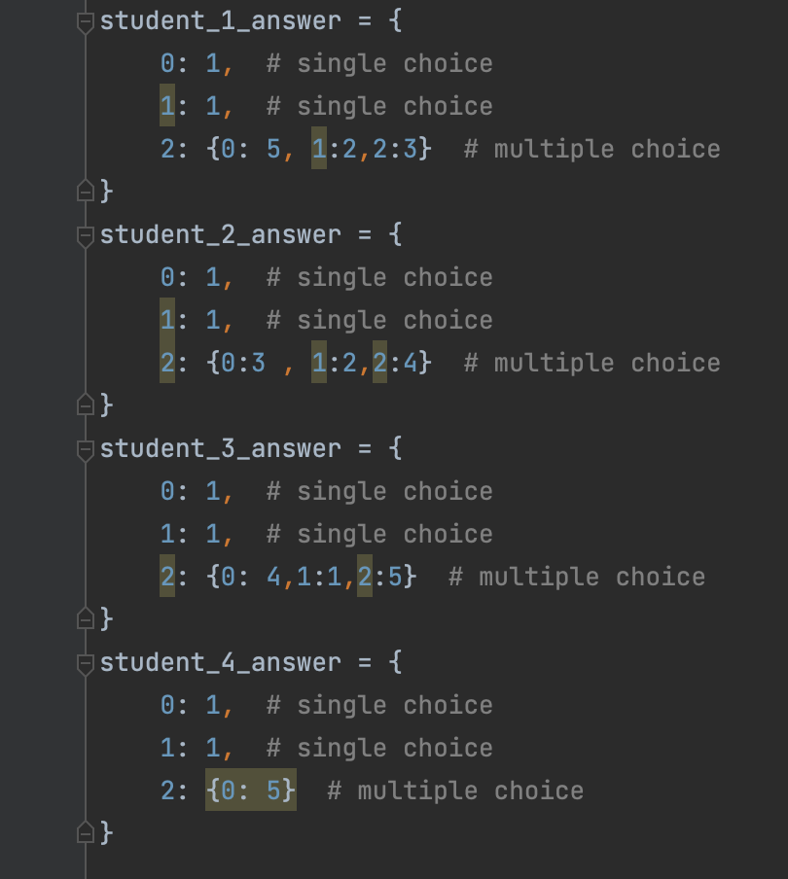
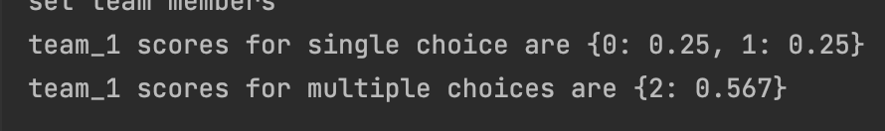
Algorithm
#2 Choose-any-or-all-of Question
Example #1 :

Slide 13
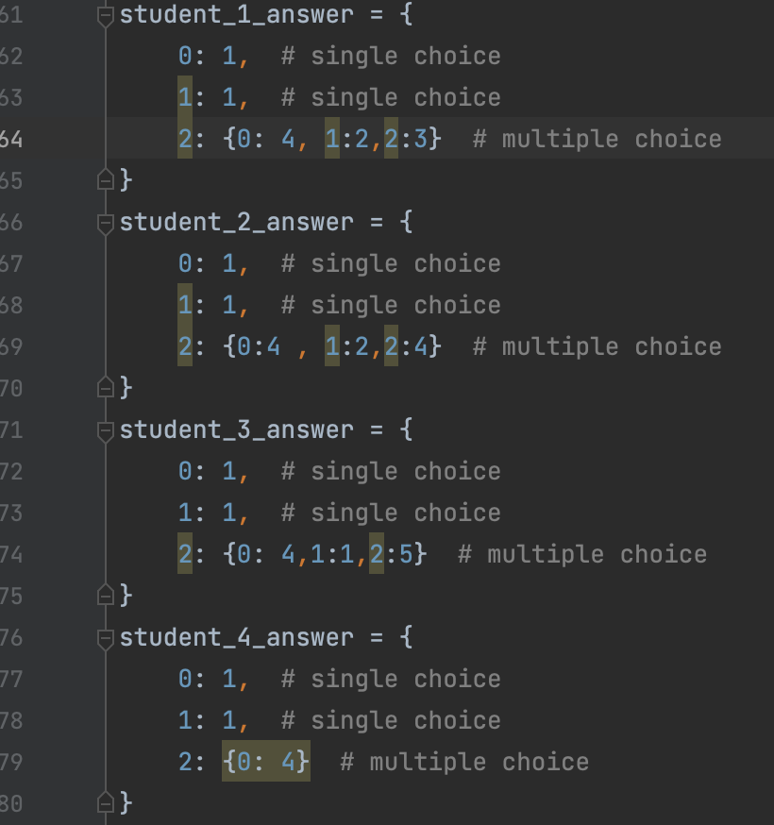
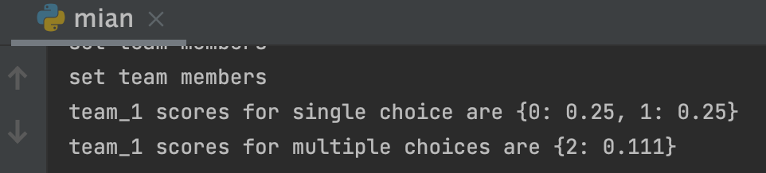
Algorithm
#2 Choose-any-or-all-of Question
Example #2 :
More similarity, since all student’s first preference is 4

Slide 14
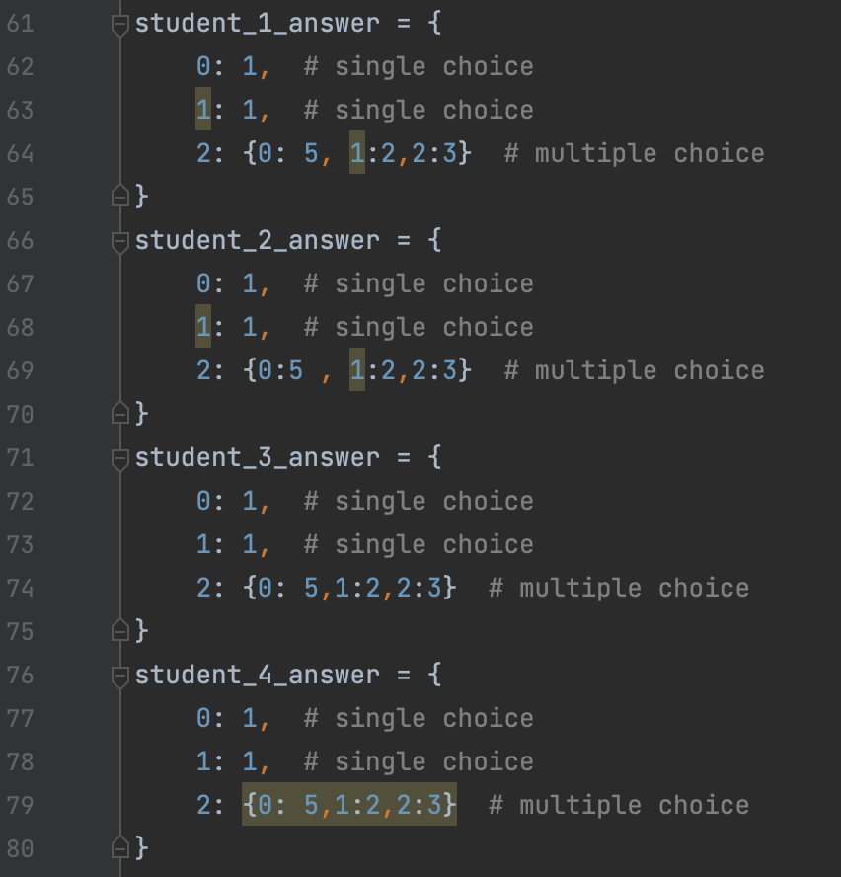
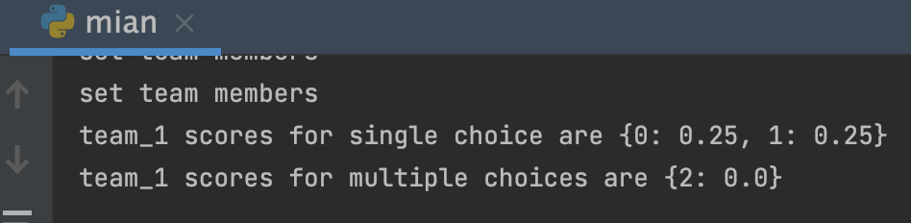
Algorithm
#2 Choose-any-or-all-of Question
Example #3 :
max similarity, everyone in the team has the same preference

Slide 15
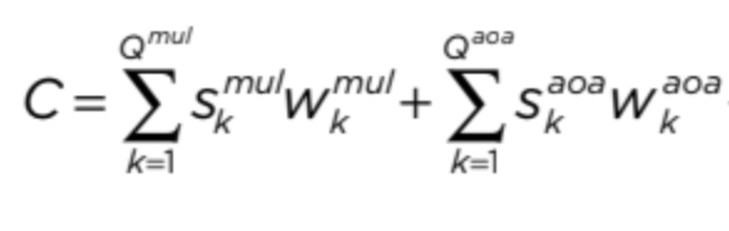
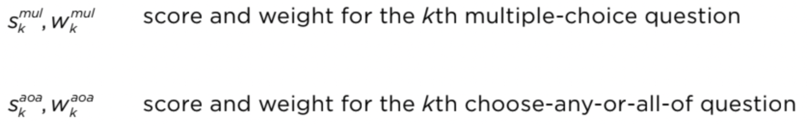
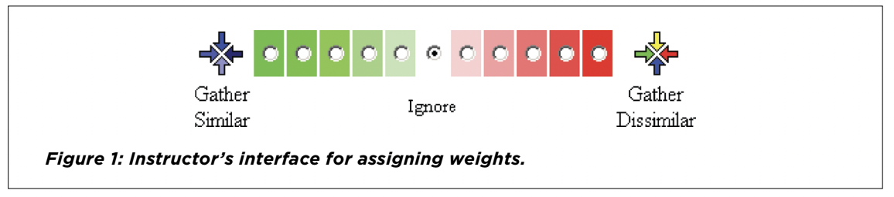
Algorithm
Team compliance score:

Slide 16
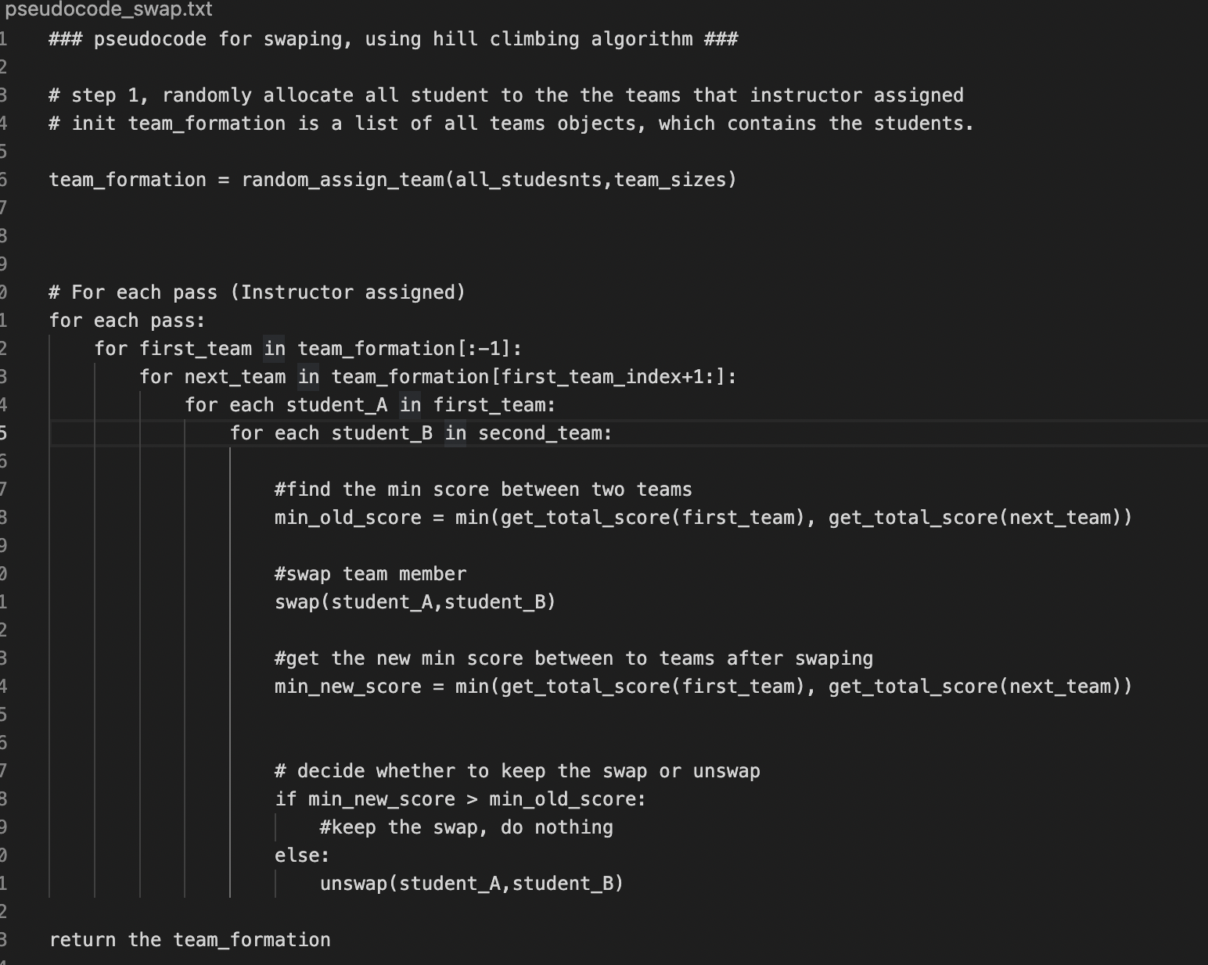
Algorithm
Swap

Slide 17
Existing essential user stories
Signup
Login / Logout
Add question (choice options) / delete question (choice options)
Run the algorithm
Display the running result

Slide 18
Existing optional user stories
Add / remove student in / from the system manually
Make up student’s answer in the system
Add / remove student in / from a team manually in the system.
Distribute team manually.
Add / remove team in / from the system manually
Remove survey

Slide 19
New added essential user stories
As an instructor, I want to import student survey data in .cvs or .json files, so that I can easily manage data sources.
Making good use with google form of making survey.

Slide 20
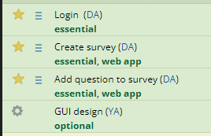
For management
Pivotal Tracker
Set up stories’ priority and give them scores by its type (essential, optional, chore)
Keep requirements simple and try not change existing ones

Slide 21
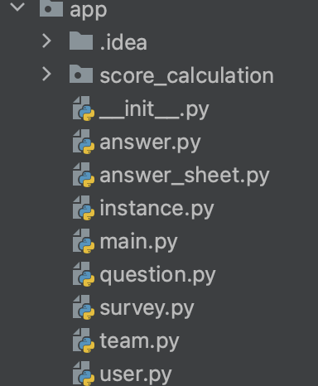
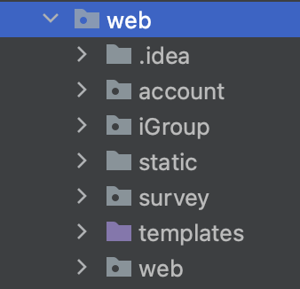
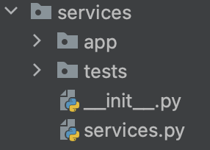
Software architecture
Middleware
(provide service)
Algorithm application interface(Pure python)
Django web framework

Slide 22
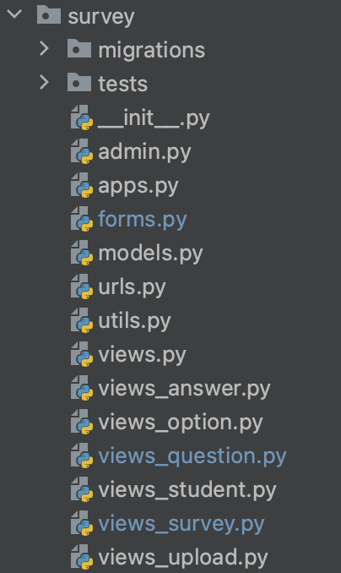
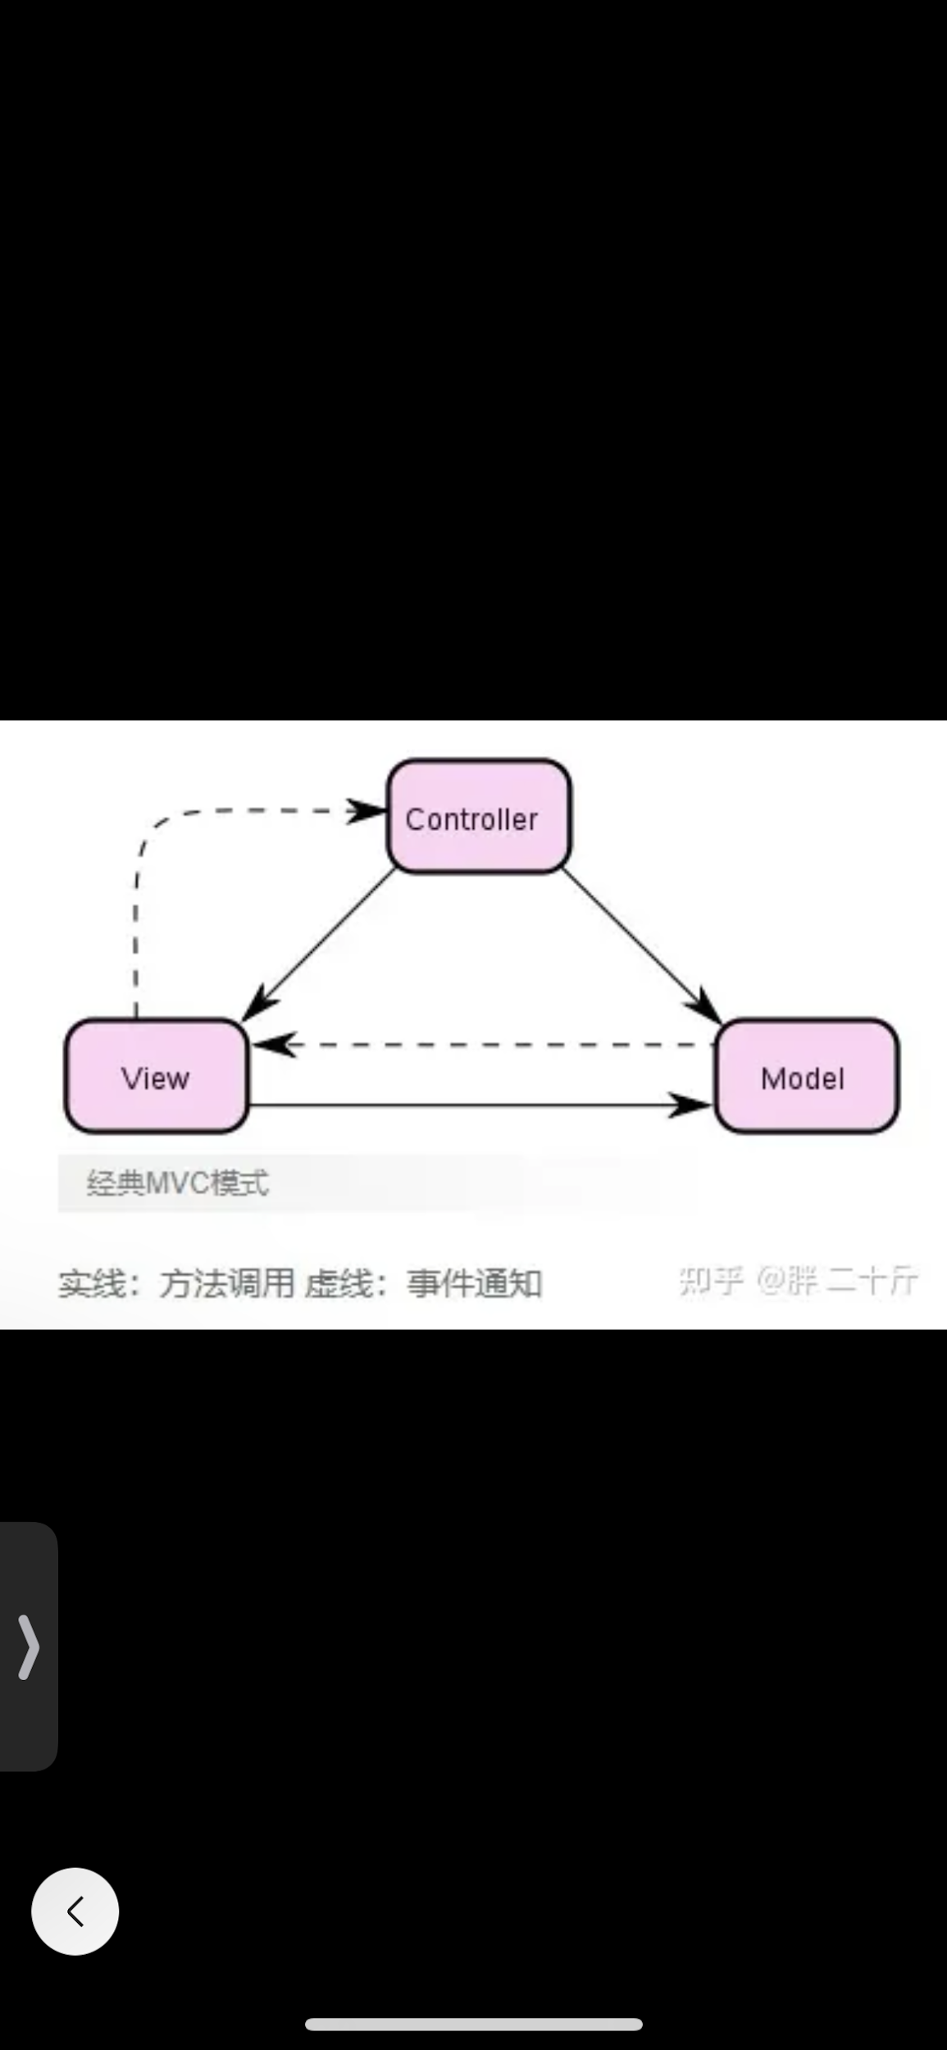
Django MVC
Controller -> View in django
View -> Templates
Model = Model

Slide 23


Django applications
Account: instructor authentication
iGroup: manage instances,run algorithm,show result, monitor student response.
Survey: create survey, answer survey question.

Slide 24
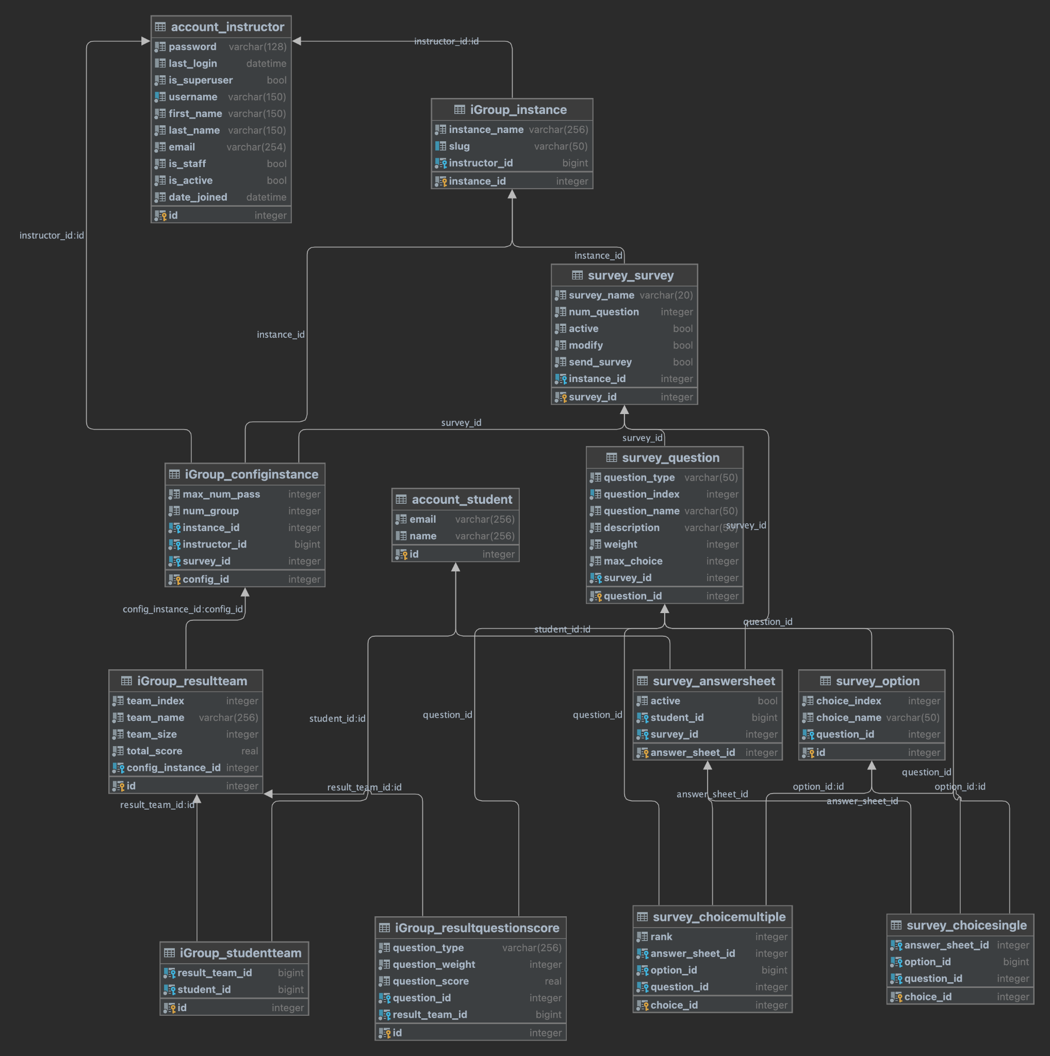
Database design (SQLite)

Slide 25
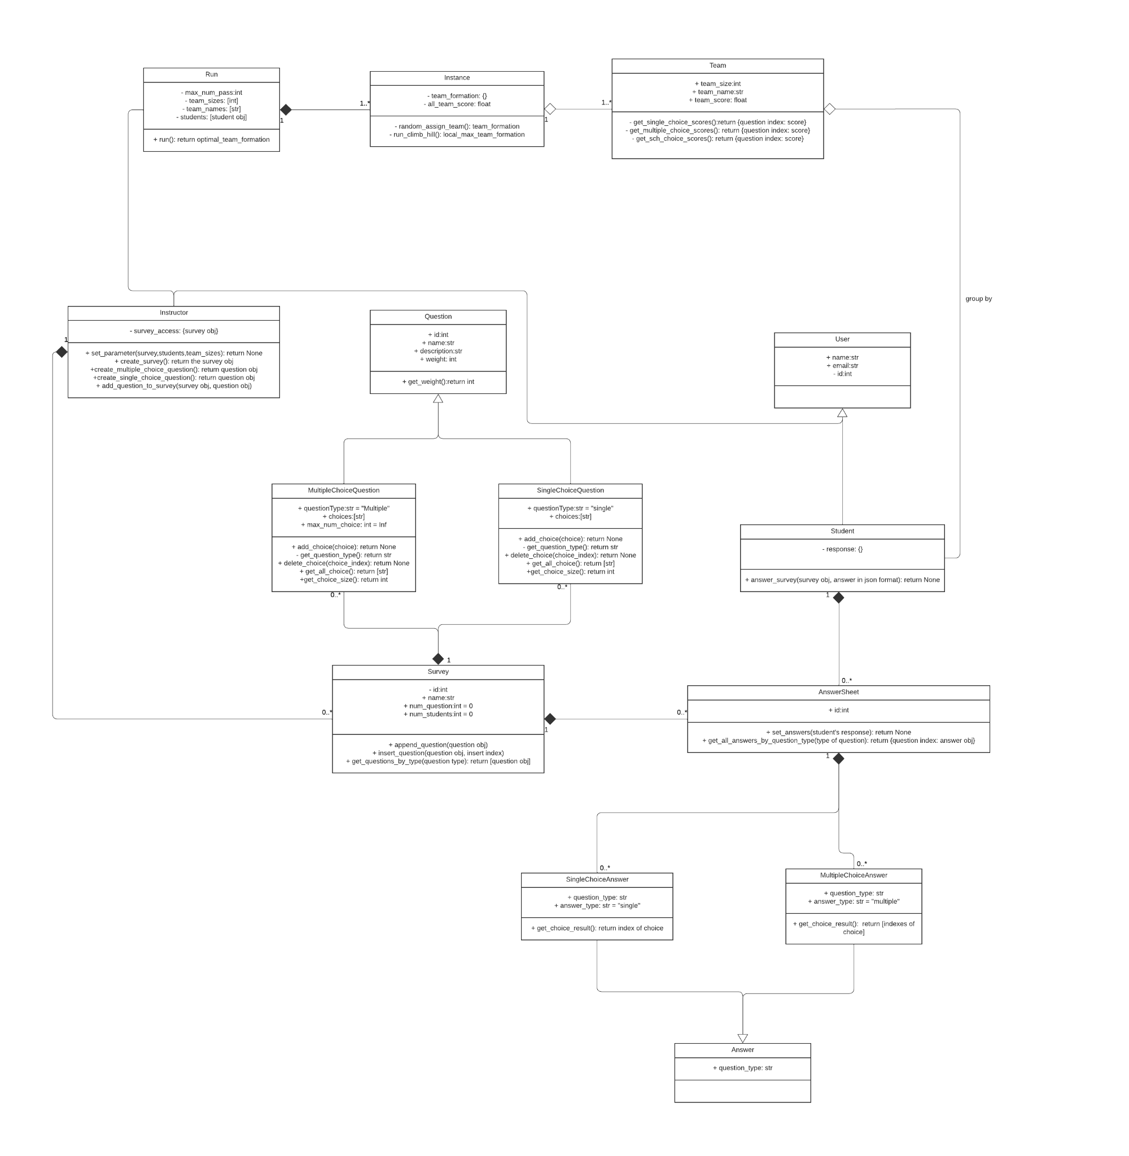
Class Diagram

Slide 26
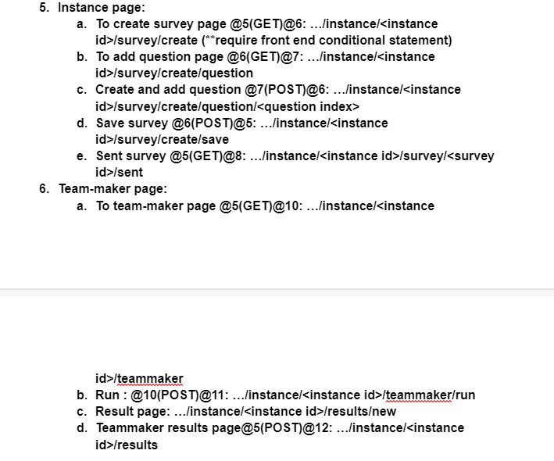
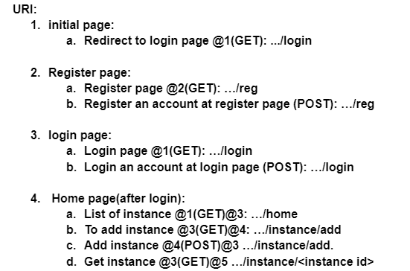
URL

Slide 27
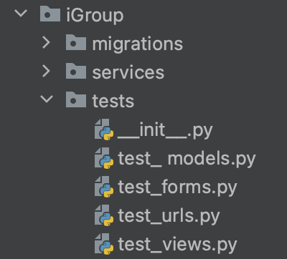
Tests in Django
In each application:
test for
models
forms
urls
views

Slide 28
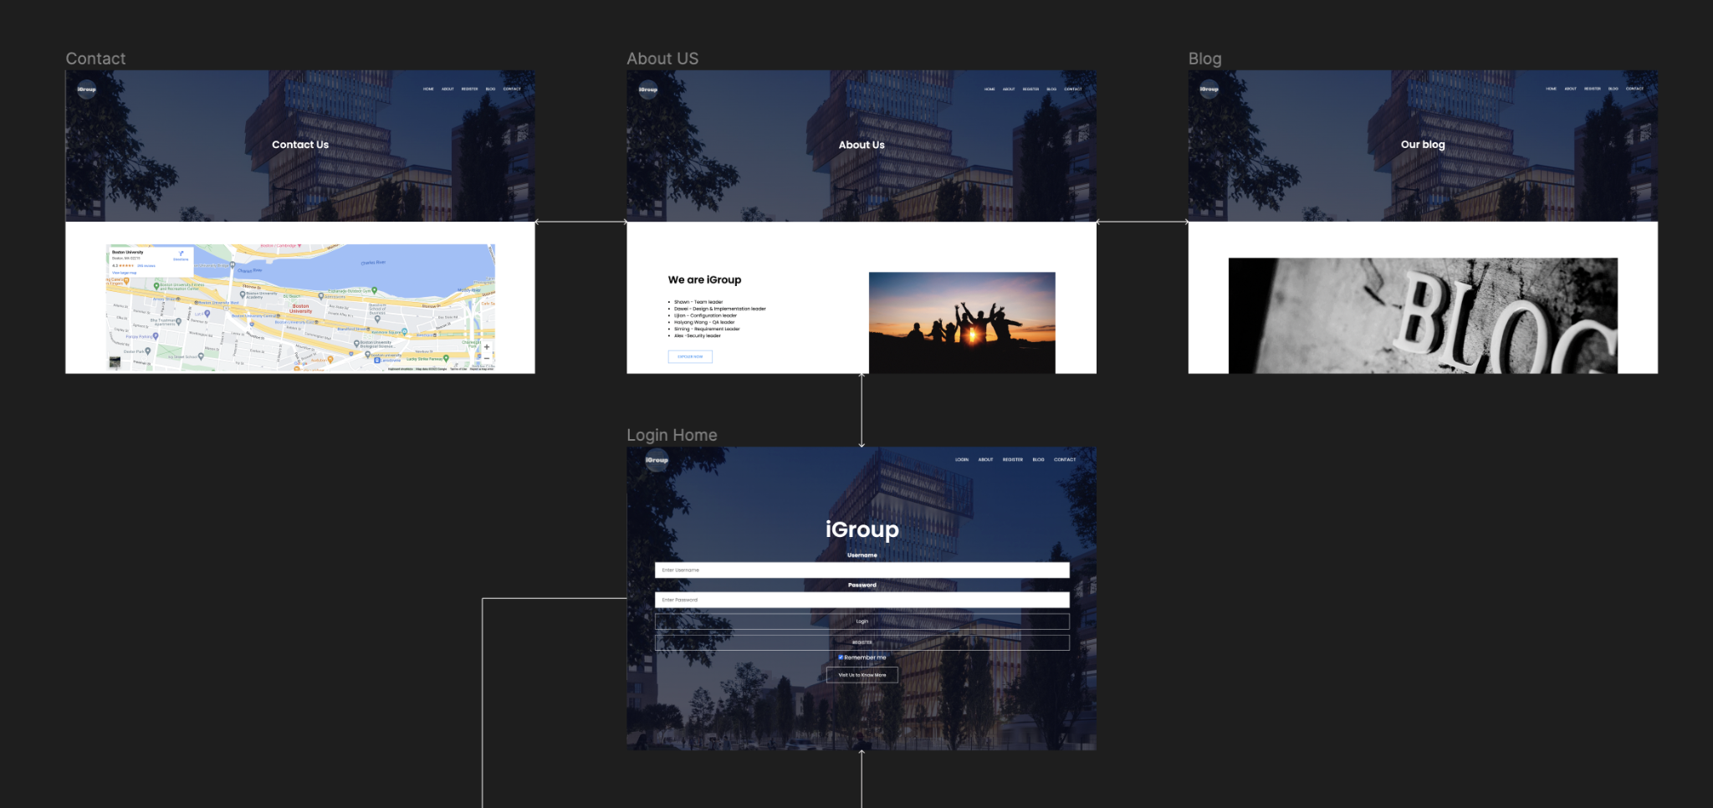
UI design

Slide 29
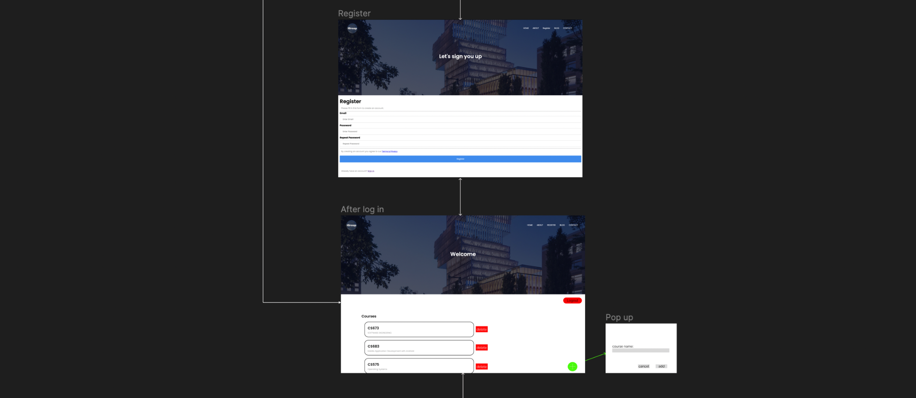
UI design

Slide 30
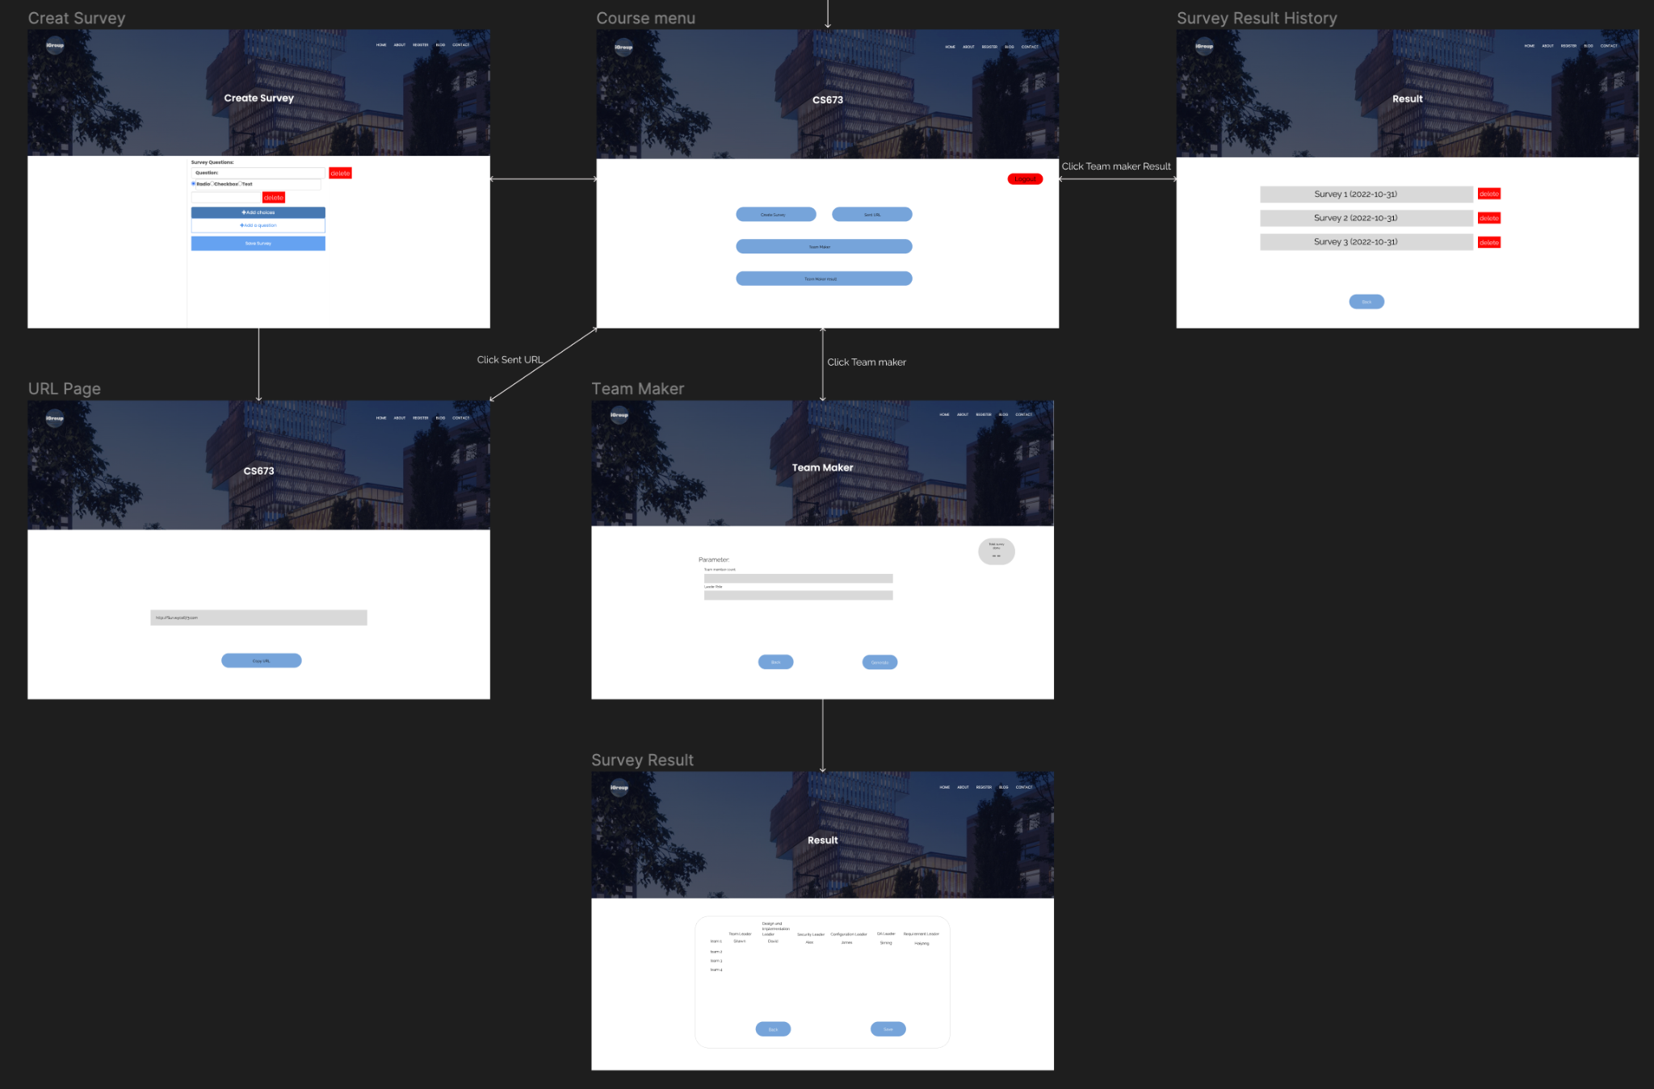
UI design

Slide 31
Demo

Slide 32
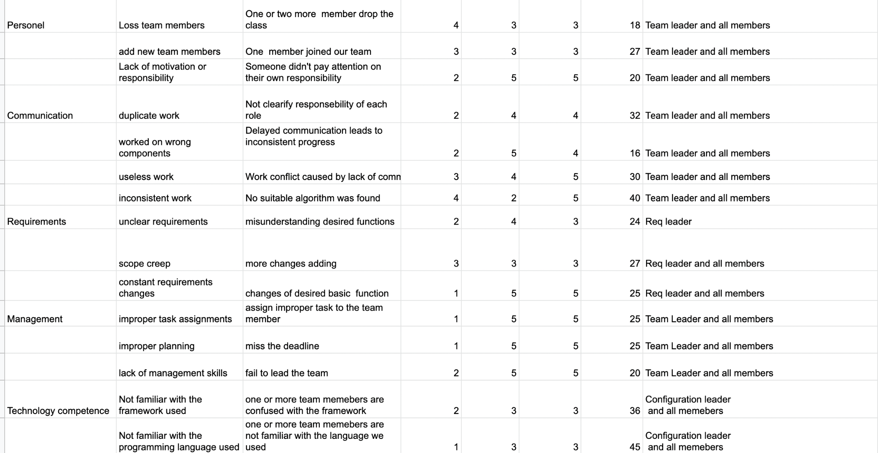
Conclusion
risk management

Slide 33
Conclusion
risk management
iteration evolution
achievements of the project
challenges in the project
lesson learned

Slide 34
Thanks for Watching!!!

